Slide 1
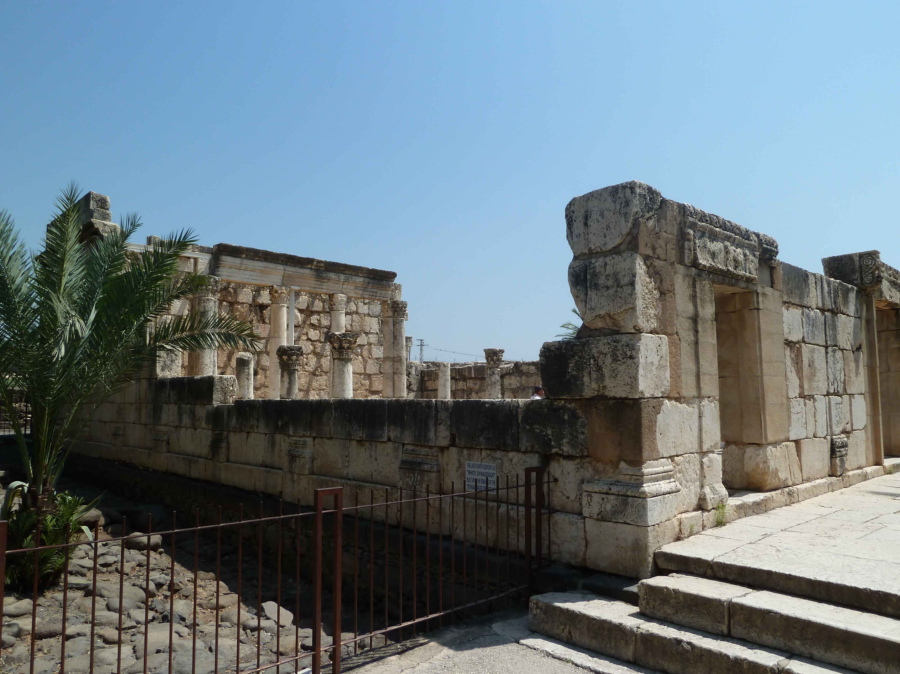
John 6.41-71
3rd Century Synagogue in Capernaum, built on
the foundation of the synagogue where Jesus taught

Slide 2
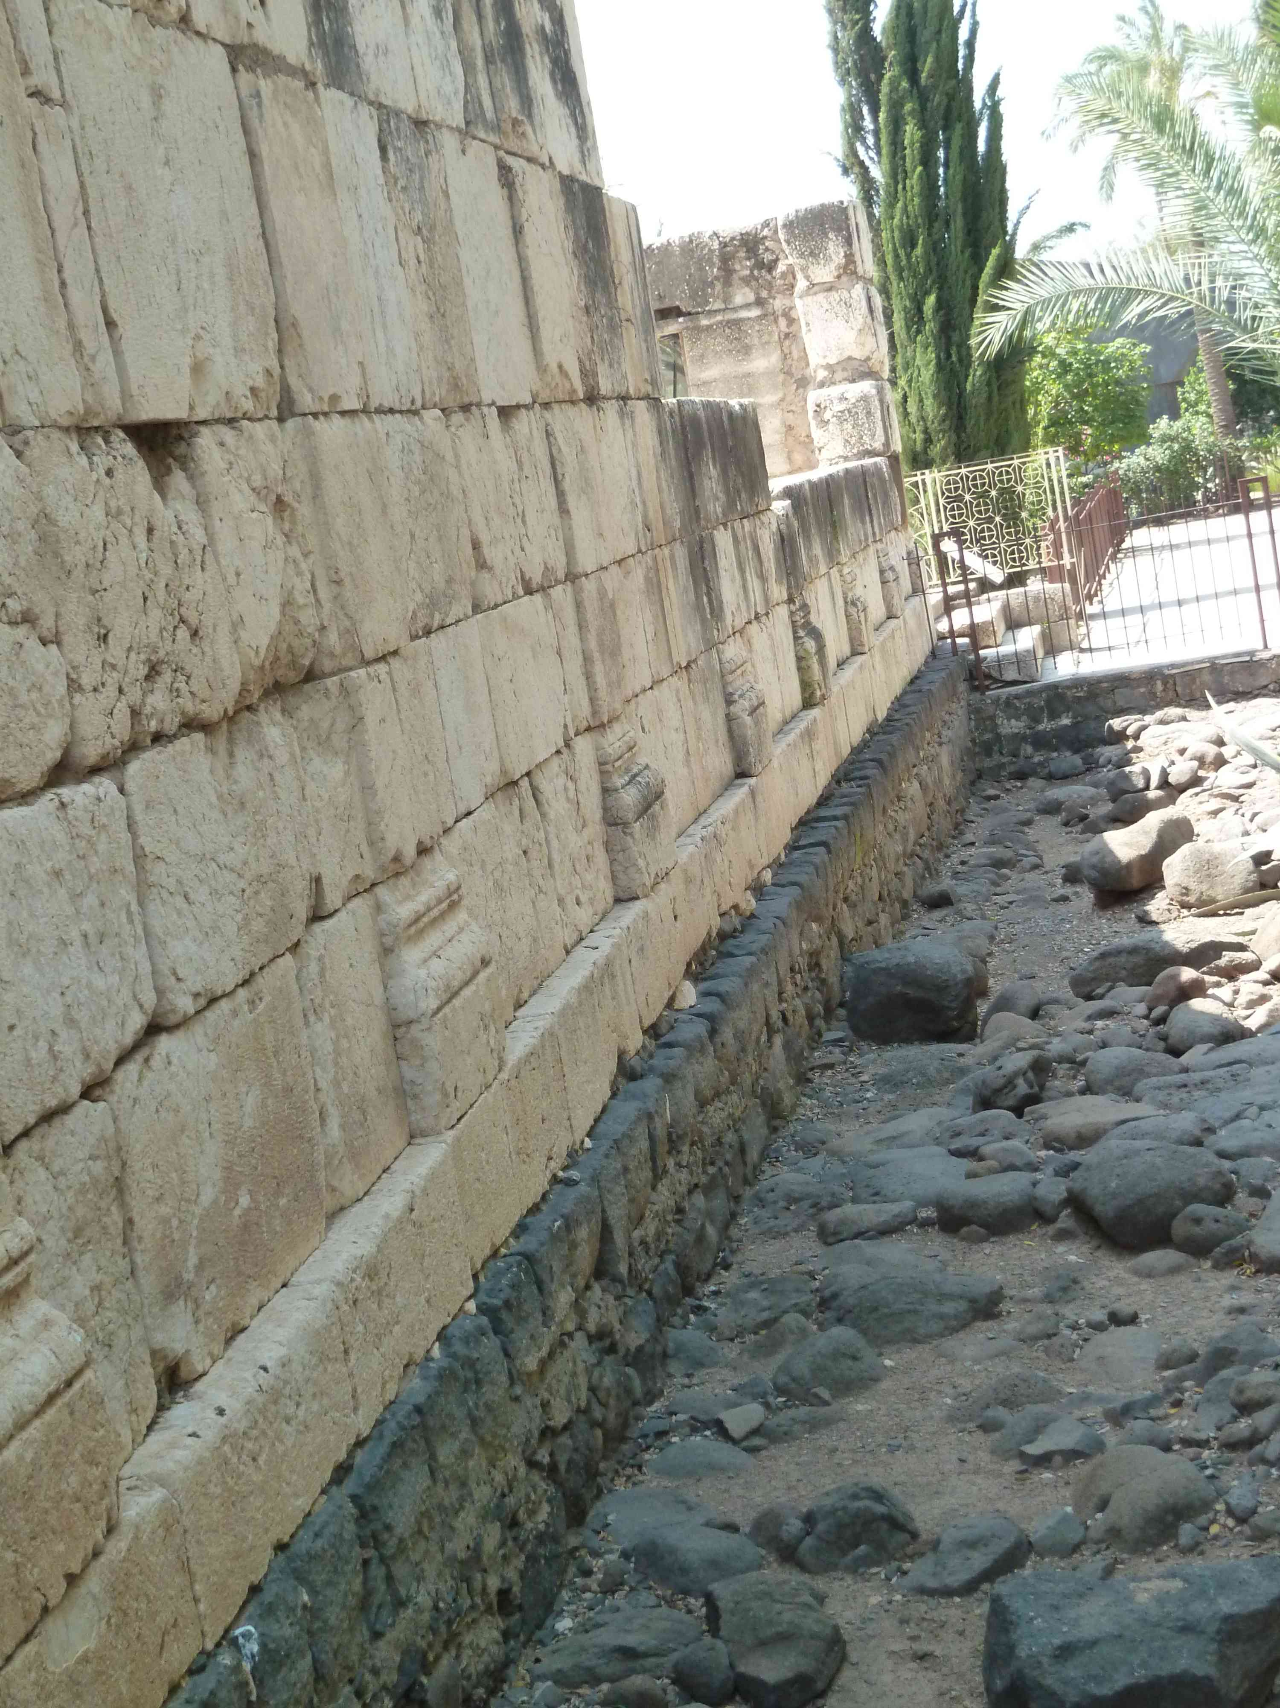
John 6.41-42 NET: Then the Jews who were hostile to Jesus began complaining about him because he said, “I am the bread that came down from heaven,” ⁴²and they said, “Isn't this Jesus the son of Joseph, whose father and mother we know? How can he now say, ‘I have come down from heaven’?”
Foundation from Jesus’ Day

Slide 3
John 6.43-46: Jesus replied, “Do not complain about me to one another. ⁴⁴No one can come to me unless the Father who sent me draws him, and I will raise him up at the last day. ⁴⁵It is written in the prophets, ‘And they will all be taught by God.’ Everyone who hears and learns from the Father comes to me.” ⁴⁶(Not that anyone has seen the Father except the one who is from God– he has seen the Father.)
Foundation from Jesus’ Day

Slide 4
John 6.47-51: “I tell you the solemn truth, the one who believes has eternal life. ⁴⁸I am the bread of life. ⁴⁹Your ancestors ate the manna in the wilderness, and they died. ⁵⁰This is the bread that has come down from heaven, so that a person may eat from it and not die. ⁵¹I am the living bread that came down from heaven. If anyone eats from this bread he will live forever. The bread that I will give for the life of the world is my flesh.”

Slide 5
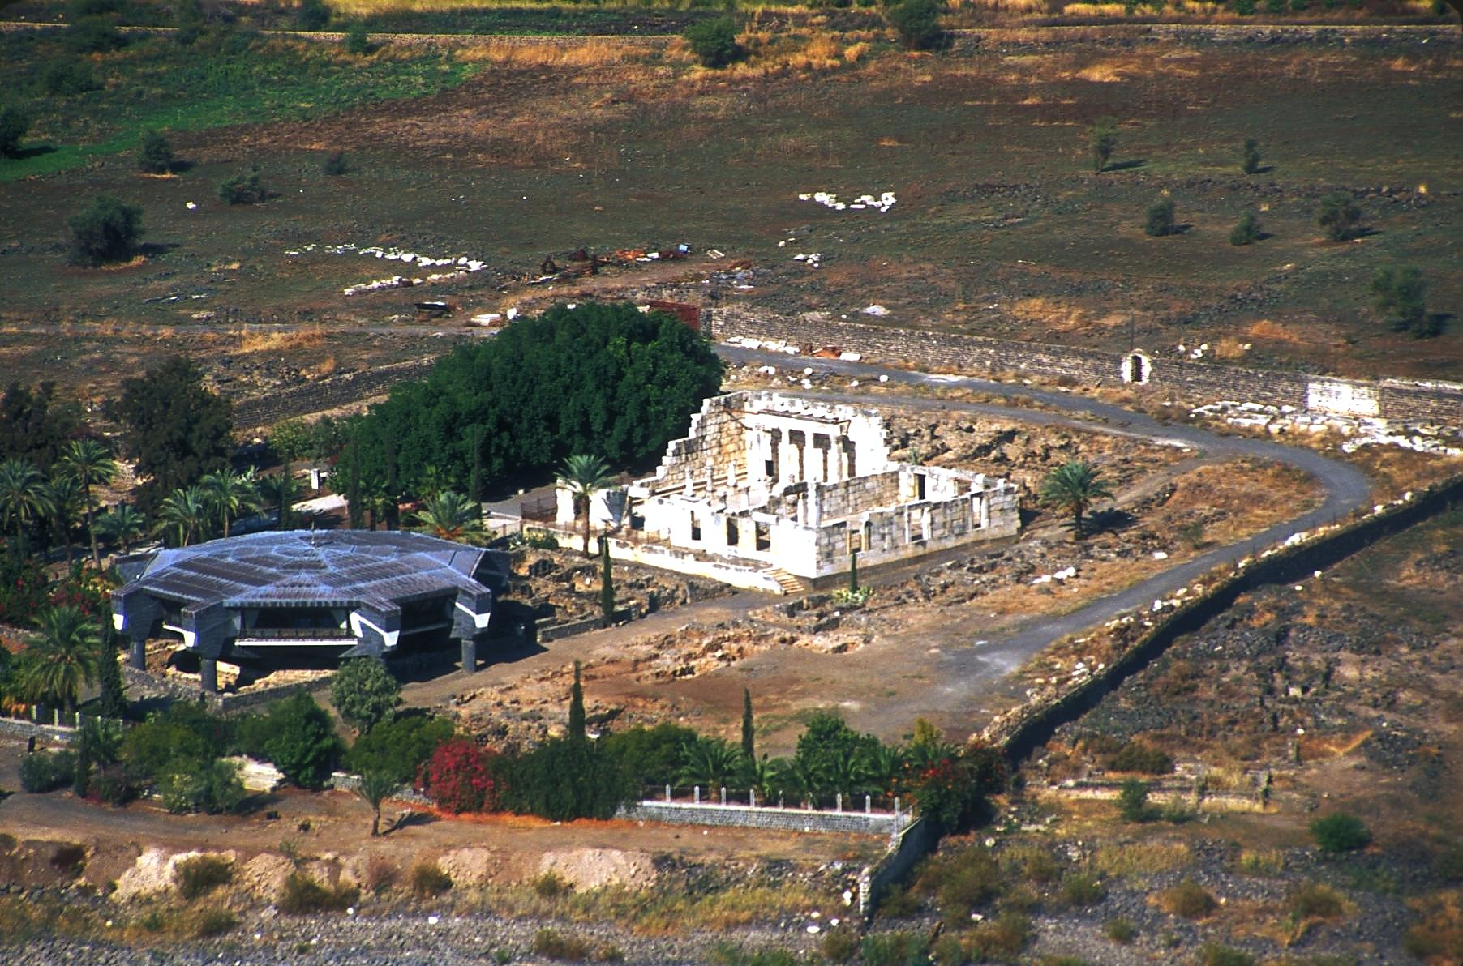
John 6.52-55: Then the Jews who were hostile to Jesus began to argue with one another, “How can this man give us his flesh to eat?” ⁵³Jesus said to them, “I tell you the solemn truth, unless you eat the flesh of the Son of Man and drink his blood, you have no life in yourselves. ⁵⁴The one who eats my flesh and drinks my blood has eternal life, and I will raise him up on the last day. ⁵⁵For my flesh is true food, and my blood is true drink.”
©2006 Todd Bolen www.bibleplaces.com

Slide 6
John 6.54: “The one who eats my flesh and drinks my blood has eternal life, and I will raise him up on the last day.”
John 6.40: “For this is the will of my Father– for everyone who looks on the Son and believes in him to have eternal life, and I will raise him up at the last day.”
©2006 Todd Bolen www.bibleplaces.com

Slide 7
John 6.51: “I am the living bread that came down from heaven. If anyone eats from this bread he will live forever. The bread that I will give for the life of the world is my flesh.”
John 6.35: “I am the bread of life. The one who comes to me will never go hungry, and the one who believes in me will never be thirsty.”
©2006 Todd Bolen www.bibleplaces.com

Slide 8
John 6.56-59: “The one who eats my flesh and drinks my blood resides in me, and I in him. ⁵⁷Just as the living Father sent me, and I live because of the Father, so the one who consumes me will live because of me. ⁵⁸This is the bread that came down from heaven; it is not like the bread your ancestors ate, but then later died. The one who eats this bread will live forever.” ⁵⁹Jesus said these things while he was teaching in the synagogue in Capernaum.

Slide 9
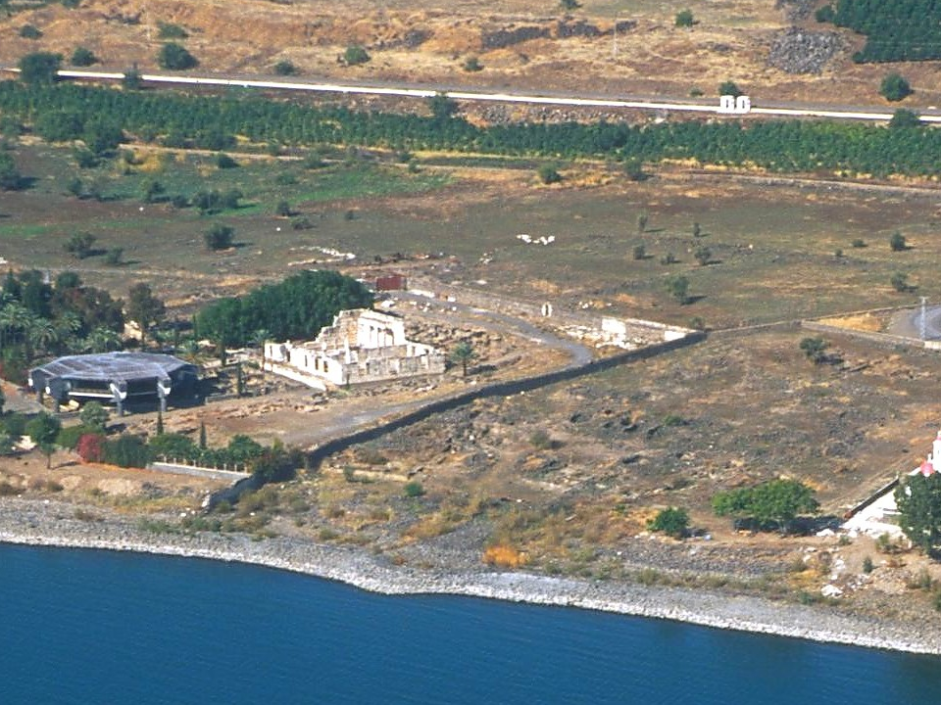
John 6.56: “The one who eats my flesh and drinks my blood resides in me, and I in him.”
John 6.54: “The one who eats my flesh and drinks my blood has eternal life, and I will raise him up on the last day.”
Synagogue
©2006 Todd Bolen www.bibleplaces.com

Slide 10
John 6.60-62: Then many of his disciples, when they heard these things, said, “This is a difficult saying! Who can understand it?” ⁶¹When Jesus was aware that his disciples were complaining about this, he said to them, “Does this cause you to be offended? ⁶²Then what if you see the Son of Man ascending where he was before?”

Slide 11
John 6.60-62: Then many of his disciples, when they heard these things, said, “This is a difficult saying! Who can understand it?” ⁶¹When Jesus was aware that his disciples were complaining about this, he said to them, “Does this cause you to be offended? ⁶²Then what if you see the Son of Man ascending where he was before?”
σκανδαλίζω
“scan-duh-LEE-dzoh”

Slide 12
John 6.63-66: “The Spirit is the one who gives life; human nature is of no help! The words that I have spoken to you are spirit and are life. ⁶⁴But there are some of you who do not believe.” (For Jesus had already known from the beginning who those were who did not believe, and who it was who would betray him.) ⁶⁵So Jesus added, “Because of this I told you that no one can come to me unless the Father has allowed him to come.” ⁶⁶After this many of his disciples quit following him and did not accompany him any longer.

Slide 13
John 6.67-71: So Jesus said to the twelve, “You don't want to go away too, do you?” ⁶⁸Simon Peter answered him, “Lord, to whom would we go? You have the words of eternal life. ⁶⁹We have come to believe and to know that you are the Holy One of God!” ⁷⁰Jesus replied, “Didn't I choose you, the twelve, and yet one of you is the devil?” ⁷¹(Now he said this about Judas son of Simon Iscariot, for Judas, one of the twelve, was going to betray him.)

Slide 14
If God chooses you…
1. You will come to have faith in Jesus
A. You will depend and believe
B. You will eat his flesh & drink his blood
[accept his sacrifice for you]
2. You will remain in Jesus and he in you
A. You will be intimate with him always
B. You will enjoy true life forever
C. You will receive empowerment now
D. You will grow in desire to follow him

